Slide 1
Buyer Training: Colgate Unimarket Banner Finance J.P. Morgan
PLEASE DOWNLOAD THIS FILE TO YOUR DESKTOP TO VIEW.
Depending upon your version of PowerPoint you may need to click “Enable” above to continue.

Slide 2
Executive Summary / Overview:
This course is part of Colgate University’s strategy to ensure that our campus community is best equipped to spend effectively.
Please review each topic carefully.
At the end of this overview, there is a certification attestation.
You will be notified of updates to this course should guidance change.

Slide 3
More Questions?
If you still have questions after completing this course, please email purchasing@colgate.edu
Your questions and emails are important and will be forwarded to staff members who are best suited to answer your question(s).

Slide 4
Purchasing
Buying – Purchasing – Procurement - Sourcing

Slide 5
Purchasing is the process of exchanging a written “promise to pay” for a good or service. Colgate University has an electronic marketplace (i.e. Colgate Unimarket) which interfaces with Banner Finance, the system of record. Purchasing can be as simple as “spot buying” on a suppliers web site or as complicated as a construction or professional services agreement.
The qualified difference is how much goes into our decisions to buy something as a fiduciary agent of Colgate University: a New York state 501(c)3 non-profit institution implementing it’s Third Century Plan amidst a global pandemic.

Slide 6
Purchasing
Purchasing decisions are delegated to individual departments subject to compliance with University Purchasing Policy and Procedures.
Every student, faculty, and staff member has a user profile in the Banner ERP (Enterprise Resource Planning) system.
A User Profile Form is managed by the Office of Human Resources with assistance from Banner Finance and ITS staff.
Questions, concerns, or requests for changes should be directed to your supervisor. Then, Drew Porter or Clark Marshall may be contacted to refresh your access levels based on your job descriptions.

Slide 7
Purchasing philosophy
In these COVID-19 times, remote work, social distancing, electronic communication, reduced spending, and increased scrutiny has accelerated the need for electronic purchasing. Colgate University led a New York Six Consortium and selected Unimarket as its electronic marketplace.
Colgate Unimarket is simply an application that improves the interface between vendors’s online ordering with Colgate’s Banner Finance system.
Streamlining these processes enables better planning and coordination.
Colgate University strives to offer economic opportunity to local, diverse, historically disadvantaged, and woman-owned business enterprises (i.e. Diversity and Economic Inclusion).
Colgate University buyers must act as responsible stewards to scarce funds in order to maximize the benefits towards its students / stakeholders / constituents.

Slide 8
Resources
Online resources include Colgate University web pages or subject matter experts in Finance and Administration, Accounting & Control, and Purchasing departments.
Here are some helpful links:
Finance and Administration (link)
Accounting and Control (link)
Purchasing (link)
Purchasing’s relevant links are:
Colgate University Purchasing Policies and Procedures
Colgate University Purchase Order terms and conditions
Colgate Unimarket Buyer’s Guide

Slide 9
Purchasing Mission and Vision
Mission
The mission of the Colgate University’s Purchasing Department is to be a key strategic partner for the Colgate community in the acquisition of world-class goods and services at the best-value through its purchasing systems, procurement expertise, end-user education, and outstanding customer service.
Vision
The vision of the Colgate University’s Purchasing Department is to be recognized for our innovative approach to sourcing, development of strategic alliances, and a progressive model of best practices all in support of the mission and strategic plan of Colgate University.
https://www.colgate.edu/about/third-century-plan/third-century-plan

Slide 10
Purchase Order terms and conditions (T&C’s)
1. Offer and Acceptance; Terms Exclusive |  | 16. Indemnification
2. Deliverables Being Purchased |  | 17. Entire Agreement
3. Time of Performance |  | 18. Financial Responsibility
4. Delivery and Transportation |  | 19. Modification
5. Price, Invoicing, and Payment |  | 20. Controlling Law; Jurisdiction
6. Changes |  | 21. Assignment
7. Quality |  | 22. Notices
8. Quantity; Count |  | 23. Dispute Resolution
9. Responsibilities of Seller |  | 24. Non Discrimination
10. Default |  | 25. Web Content Accessibility
11. Insurance |  | 26. GDPR Compliance
12. Force Majeure |  | 27. Confidential Information
13. Patents and Proprietary Rights |  | 28. Sustainability
14. Warranties |  | 29. Federal Awards and Grants
15. Right of Termination |  | 30. Safety and Environmental

Slide 11
Purchasing Policies and Procedures
General Policies | 1.1 Code of Ethics |  | Purchasing with Federal Grants | 4.0 Federal Awards and Grants
 | 1.2 Gifts and Gratuities from Vendors |  |  | 4.1 Conflict of Interest
 | 1.3 Conflict of Interest |  |  | 4.2 Specifications Development using an Outside Source
 | 1.4 Supplier Diversity |  |  | 4.3 Micro-Purchase
 | 1.5 Local Business |  |  | 4.4 Small Purchase
 | 1.6 Environmentally Preferable Purchasing (EPP) |  |  | 4.5 Sealed Bids
Vendor Policies | 2.1 Vendor Approval and Status |  |  | 4.6 Sealed Request for Proposal (RFP)
 | 2.2 Vendor Qualification |  |  | 4.7 Non-Competitive Purchases
 | 2.3 Vendor Suspension |  |  | 4.8 Breaking Down Orders
Purchasing | 3.1 Dollar Thresholds and Purchasing Methods |  |  | 4.9 Contract Provisions
 | 3.2 Request for Information (RFI) |  |  | 4.10 Federal Debarment and Suspension
 | 3.3 Request for Quotes (RFQ) |  |  | 4.11 Contracting with MBE, WBE & Small Business
 | 3.4 Request for Bids (RFB) |  |  | 4.12 Economic Purchases
 | 3.5 Request for Proposals (RFP) |  |  | 4.13 Construction
 | 3.6 Requisitions |  | Ancillary Purchasing Policies | 5.1 Disposal of University Owned Equipment
 | 3.7 Request for Waiver of Competitive Bidding |  |  | 5.2 Recording of Capital Equipment Purchases
 | 3.8 Emergency Purchases
 | 3.9 Credit Card (P-Card) Purchases
 | 3.10 Prepayments
 | 3.11 Contractual Review

Slide 12
Purchasing Systems
There are four (4) primary way to purchase*:
1) Colgate Unimarket
2) Banner Finance
3) J.P. Morgan corporate credit card
4) direct payments
*Note: “Purchasing” means “the promise” precedes “the obligation to pay.”
Reimbursements, requests for payments, payments in advance are perfunctory.

Slide 13
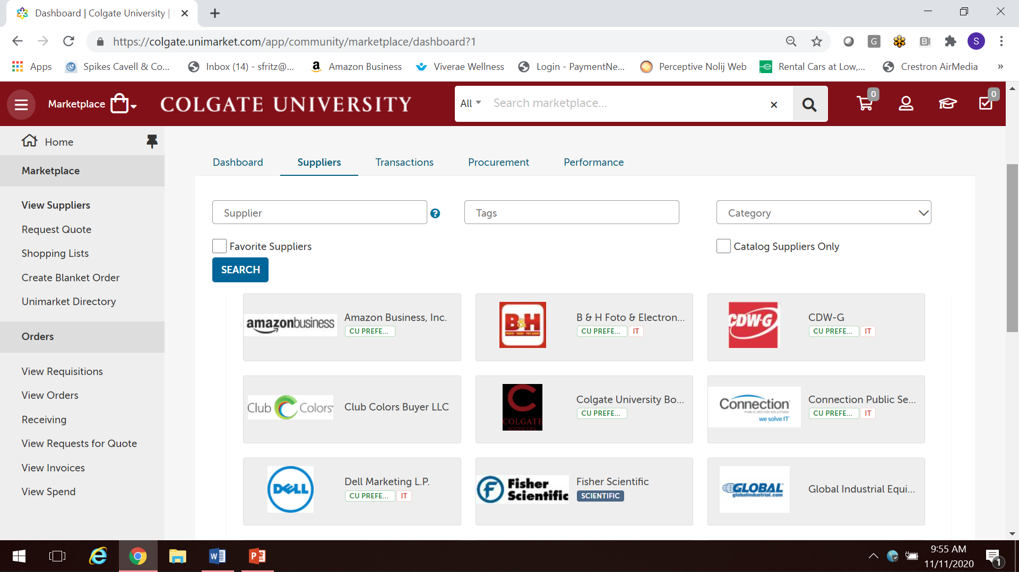
Colgate Unimarket (colgate.unimarket.com)

Slide 14
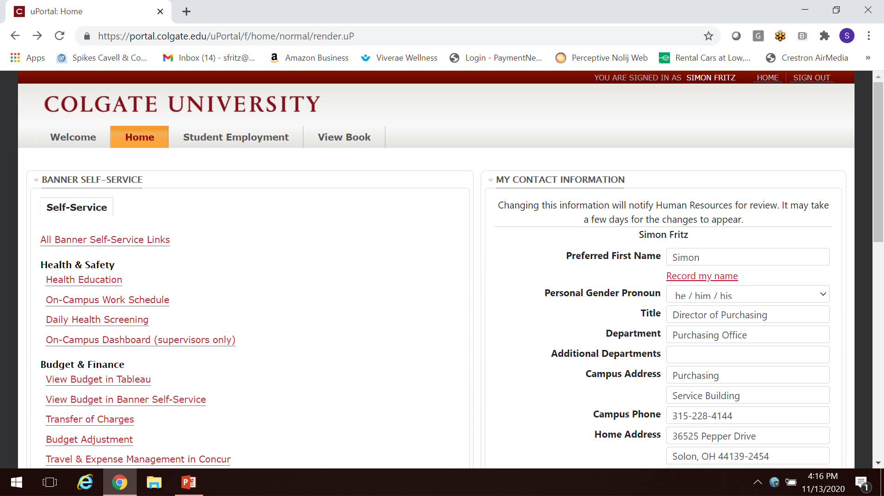
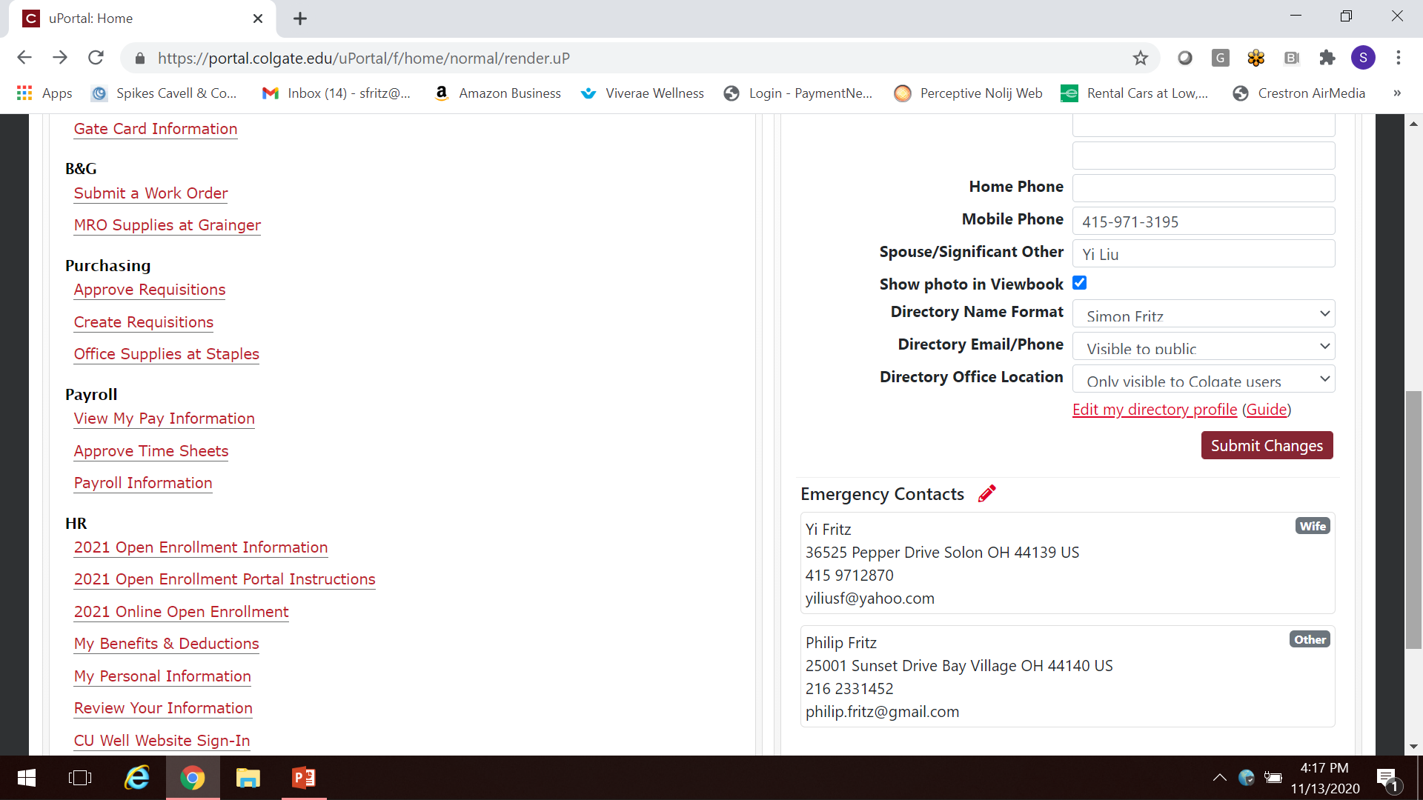
Colgate University Portal

Slide 15
Purchasing
Try Colgate Unimarket first because it can:
Dynamically create a shopping cart (i.e. a requisition) with a “connected” supplier, assign budget codes (i.e. FOAs: Fund, Organization, Accounts), and relevant attachments / approvals.
NOTE: Every supplier needs a profile in Banner Finance in order to make a payment. If you do not find a supplier you want to purchase from, Purchasing will send them a Vendor Profile Form and request a W-9 (to ensure its legal entity status) OR send them an invitation to self register in Colgate Unimarket.
Inviting them to self register is preferred because they can attach relevant documentation and business classification.

Slide 16
Colgate Unimarket structure
Colgate Unimarket consolidates approximately 250 department into
85 organization units (i.e. orgunits). For example, Colgate Athletics is called “ATHL” and encompasses approximately 70 departments.
The two primary roles are: “Browser” and “Buyer”
Everyone is a Browser for their organization units automatically.
Graduating to a Buyer means that you are a fiduciary representative of Colgate and will solicit quotes, negotiate prices, and use suppliers with beneficial terms.

Slide 17
Purchasing Matrix
Dollar Threshold* | Description | P-Card | Reimbursement | Quotation | Purchase Order / Contract** | Purchasing Channel
$0 - $499 | Small Dollar Purchase | Yes (3.9 P-Card Policy applied) | Submit invoice or request for reimbursement to Accounting / Control | No quote required. | Not required. | Colgate Unimarket or J.P. Morgan Card (requires Concur)
$500 - $999 | Order placed directly with preferred supplier through Colgate Unimarket / their online system / or contracting arrangement with direct internal budget charges. | Yes (3.9 P-Card Policy applied) | Submit Invoice or request for reimbursement to Accounting / Control | No quote required. | An online requisition / Purchase Order may be used if P-Card not accepted. No quote required. | Colgate Unimarket or J.P. Morgan Card (requires Concur)
$1,000 -$4,999 | Submit electronic requisition (i.e. shopping cart in Colgate Unimarket) with quotation. | No (3.9 P-Card Policy applied) | No. (In select cases, only subscriptions, dues, or published commercial fees may be submitted for reimbursement.) | Yes. Purchasing may request a quotation, solicit competition, or take advantage of NY state / consortium purchase agreements. | Yes. A (1) quote is required. | Colgate Unimarket or Banner Finance
$5,000 -$9,999 | Submit electronic requisition (i.e. shopping cart in Colgate Unimarket) with quotation. | No | No | Yes. Purchasing may request a quotation, solicit competition, or take advantage of NY state / consortium purchase agreements. | Yes. A (1) quotation is required. Two (2) or more quotations are encouraged. | Colgate Unimarket or Banner Finance

Slide 18
Delegation of Authority
Colgate University maintains a Delegation of Authority for its internal and federal grant purchasing requirements, which is on file with the Finance and Administration office. In general, purchases less than $10,000 may be signed by the department head, subject to contract review by the Executive Director of Risk Management / Legal Affairs, Controller, Director of Purchasing, or authorized sub-delegates.
Purchases over $10,000 but less than $50,000 may be signed by the Controller or authorized sub-delegate.
Purchases over $50,000 require the review / approval and signature of the Chief Financial Officer or sub-delegate. All Grant purchasing further requires review / approval prior to Chief Financial Officer or sub delegate signature. As a 501(c)3, all contracting authority is vested in the Colgate University Board of Trustees with further delegations to individuals, individual department heads, Purchasing, Controller, Chief Financial Officer, and the President as determined by the dollar value, complexity, and terms of purchase. Contact purchasing@colgate.edu or accounting@colgate.edu with any questions.

Slide 19
Diversity and Economic Inclusion (DEI)
Colgate University’s core values includes supplier diversity / economic inclusion.
This is tracked by supplier coding of their corporate economic status. All suppliers / bidders are strongly encouraged to become involved in supplier diversity / economic inclusion initiatives. Colgate University is committed to assisting minority and women-owned business enterprises in gaining access to business opportunities. To further expand business opportunities and enhance continued economic growth, Colgate University expects our strategic suppliers to adopt and report on similar strategies of inclusion. Colgate University believes that through our supplier diversity initiative more diverse business enterprises will have greater opportunities but will also increase their business presence at Colgate University. Supplier Diversity includes businesses that qualify as Small Disadvantaged Business (SDB), Hub Zone (HUB), or Veteran Owned Business Enterprises (VOB), or ADA (American Disability Act). To qualify as one of the above business classifications your company must be more than 50% owner, controlled and actively managed by a person meeting those requirements.
Note – Qualifying firms may be entitled to prompt payment terms of Net10 subject to certification reviews.

Slide 20
Local Business
All personnel involved in the acquisition process and/or decision-making should make an attempt to diversify sourcing opportunities to local business regardless of the funding source where such vendors are known. These vendors will be given the opportunity and afforded the information required to bid on requirements. The University will not favor any local business solely based on their status. They will be evaluated using the same criteria, and adhere to the same parameters as all other vendors. All procurements will be awarded based on "best value" for the University.
A Local Business is defined as an enterprise with its primary headquarters located within one of the following Zip Codes:
13346 Hamilton, NY 13465 Solsville, NY
13332 Earlville, NY 13355 Hubbardsville, NY
13334 Eaton, NY 13418 North Brookfield, NY
13402 Madison, NY 13408 Morrisville, NY
13310 Bouckville, NY 13460 Sherburne, NY
13484 West Eaton, NY

Slide 21
Soliciting bids – offering economic opportunity
Purchasing’s primary role is getting quotes, bids, and negotiating advantageous terms of purchase. In Colgate Unimarket, anyone may request a quote electronically or create a draft shopping cart, in which to solicit other offers to re-sell the same or similar products.
The caveat is that “cost / pricing” information from one supplier is consider “source selection sensitive” meaning, one can request pricing, but is advised to NOT share price points ag which purchase may be acceptable.
Amazon Business Prime is a dynamic market place of multiple re-sellers.
Staples Business Advantage, Grainger, etc. are E&I cooperative firms that offer their best pricing and value added services to non-profits.

Slide 22
Colgate Unimarket Tutorial Videos
Links to short video tutorials are below:
Finding suppliers (https://medialibrary.colgate.edu/Watch/unimarketdemosuppliers)
Punching out (https://medialibrary.colgate.edu/Watch/Pt64TeAk)
Placing a Staples Order (https://medialibrary.colgate.edu/Watch/Kc8q7HJb)
Placing an Amazon Order (https://medialibrary.colgate.edu/Watch/Cw3e5KQy)
Split accounting (https://medialibrary.colgate.edu/Watch/Am36Lqg2)
Receiving (https://medialibrary.colgate.edu/Watch/d6K4YeSf)
Find an order/invoice (https://medialibrary.colgate.edu/Watch/a2N5WpTe)
Changing Shipping Locations (https://medialibrary.colgate.edu/Watch/Jy6a9EZx).

Slide 23
Preferred Suppliers
Colgate has preferred suppliers that objectively offer greater benefits in exchange for our support and patronage. For example, Colgate University is a founding member of the E&I Consortium (Education & Institutional) alongside Cornell and Syracuse University. This consortium offers standard terms of services (e.g. free returns, no taxes, dedicated integration, account reviews, etc.) and pre-negotiated volume pricing discounts. At last count, Colgate uses approximately 25 E&I suppliers. For example:
Staples Business Advantage – 1000 item “hot list”
Grainger – 1000 item “hot list”

Slide 24
Spending Categorizations
Spend is categorized according to the NAICS (North American Industry Classification System) codes. Like the Dewey Decimal System, it assigns a six digit number to every type of product or service.
In Banner Finance, we use approximately 200 account codes.
In Unimarket, we have deployed high level supplier tags and key words to aid in your search.
By first identifying the NAICS code, Account Code, or key word of something you want to buy, you can more easily find suppliers that have self identified themselves as suppliers.

Slide 25
Executive Summary
Colgate Purchasing, with your help, is able to switch the dialogue around purchasing from “I need this now” to “I have this need and want to purchase it.” They describe this evolution from “spot buying” to “sourcing.”
Amazon Business Prime is a wonderful tool.
However, one can use that tool for more than “spot buying.” You can use this tool to: 1) find what you are looking for and 2) help adequately describe your requirement. Once you know your requirement, you can ask a few firms to give you a price quote. You can also ask a local or diverse supplier, if they can re-sell it under comparable terms of purchase (after all Amazon is a public marketplace). Colgate Unimarket is Colgate’s electronic marketplace.

Slide 26
Thank you for reviewing the Buyer Training instructional learning material. Please be sure to complete the Google Form acknowledging your completion. You may access the FORM here. You may be prompted to sign in to your Google account.

